Slide 1

SPATIAL DATABASE PROJECT (CS 621B)
Spatial Analysis of UK for hosting FIFA World Cup
Naveen Ramprasad

Slide 2

ABOUT FIFA WORLD CUP
WORLD CUP
32 nations of 8 groups with 4 nations in each group who play the group stage. Followed by knockout stages and the semis and the final.
FIFA
Federation International of Football Association(FIFA) is the international governing body for football which is responsible for setting rules and regulations, hosting football tournaments and also advocating for integrity and fair play
HOST OF WORLD CUP
Any country that hosts the Soccer World Cup must meet strict infrastructure requirements, amongst many other standards set by Federation International of Football Association(FIFA)

Slide 3




FIFA WORLD CUP REQUIREMENTS
FIFA STANDARDS
FIFA requires minimum 12 stadiums in a city that matches the below criteria
TRAINING STADIUMS
TRANSPORTATION
At least 12 training stadiums within a 3KMs radius from main stadiums
At least 5 airports in the city
EMERGENCY
ACCOMMODATION
Closest hospital to each stadium should be within 4KMs
Minimum of 4 hotels within 3KMs from the stadiums and 8 distinct cuisine restaurants withing 5KMs radius

Slide 4
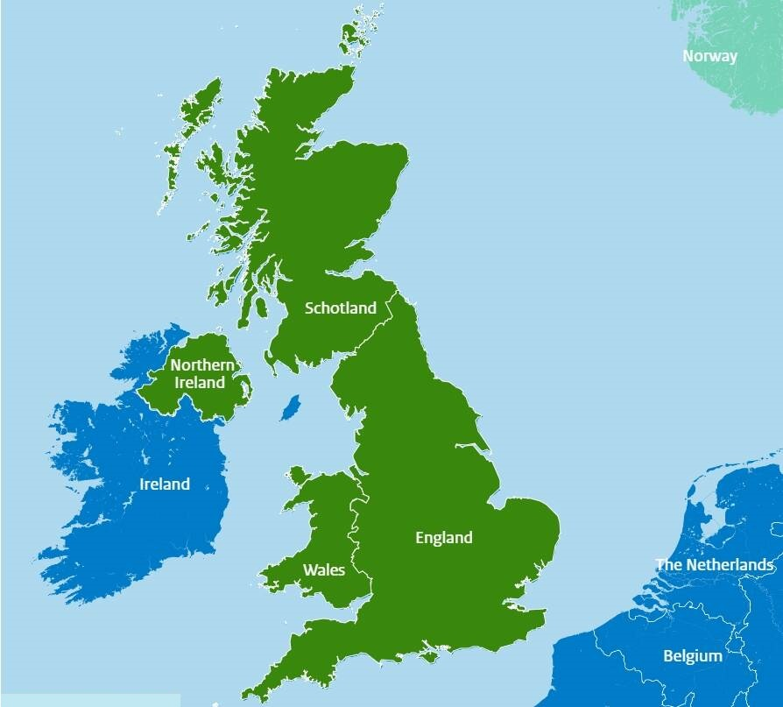
Which is the best city to host Soccer World cup in UK ?
OBJECTIVE

Slide 5
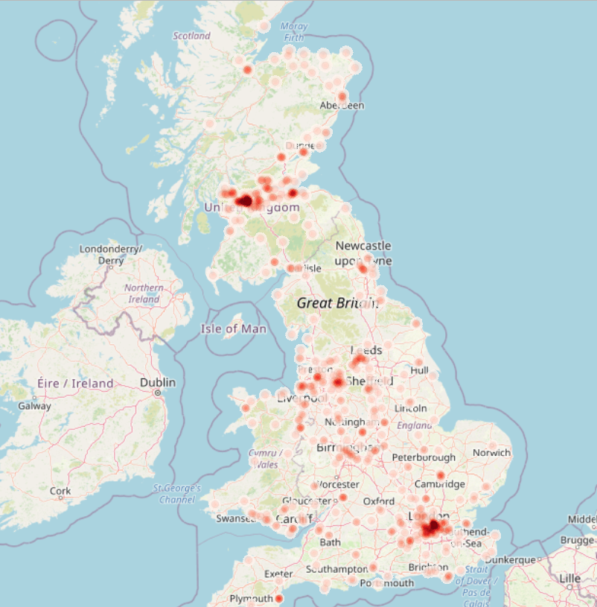


UK Map infographic
Professional Soccer Stadiums
522
Number of Stadiums owned by Professional Soccer teams in the UK
Area
242,495 km²
75%
Population
65M

Slide 6
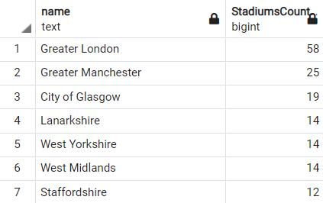
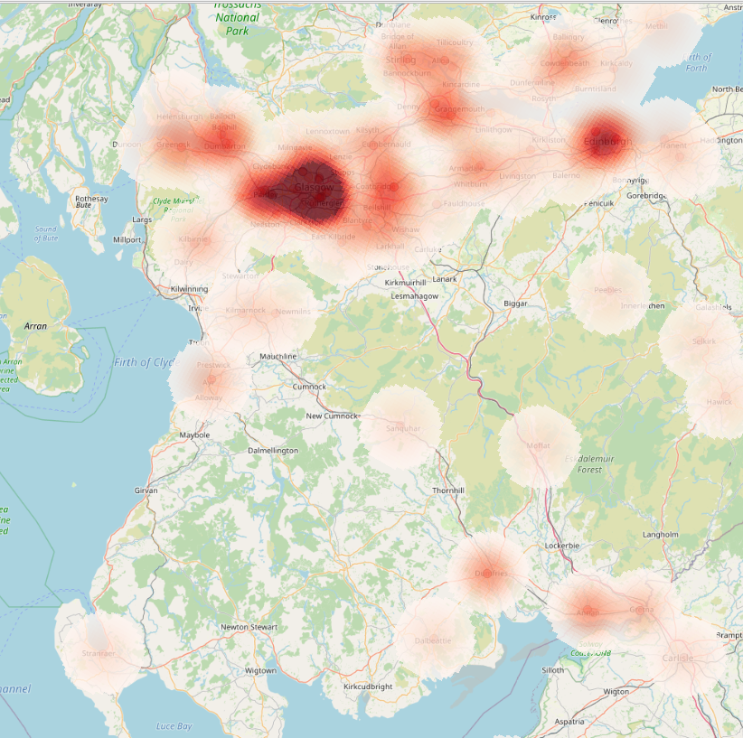
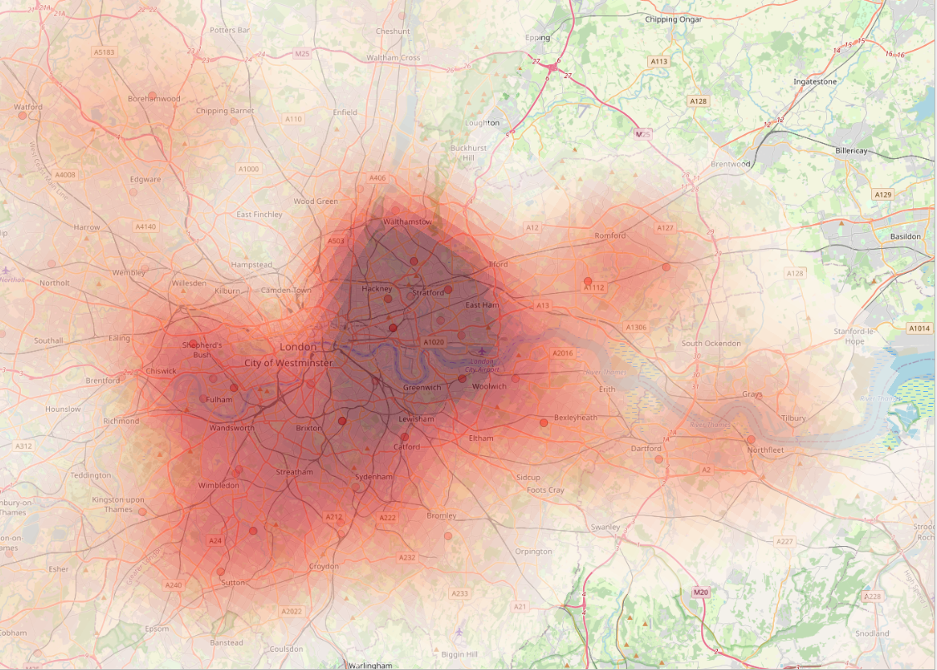
Heatmap for stadiums across UK
Greater London stands out as having the most professional football stadiums(58).
There are 6 cities that have more than 12 Soccer stadiums
Glasgow
Greater London
75%

Slide 7
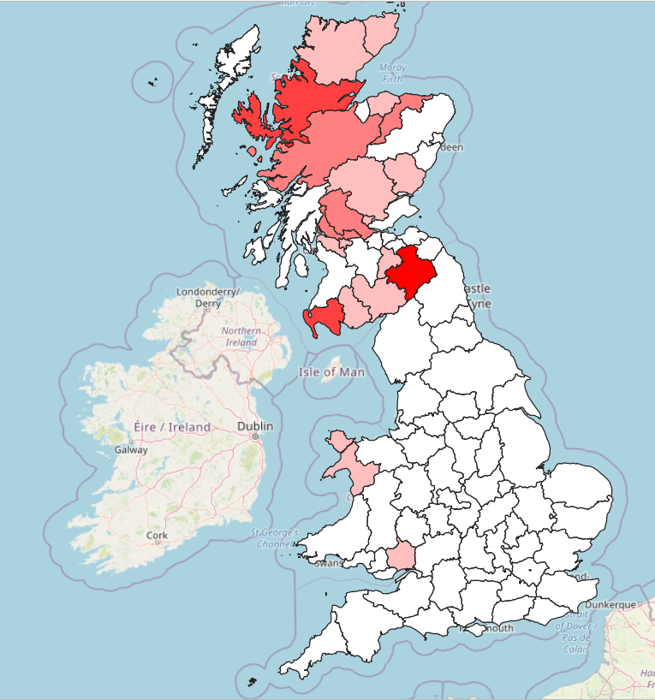
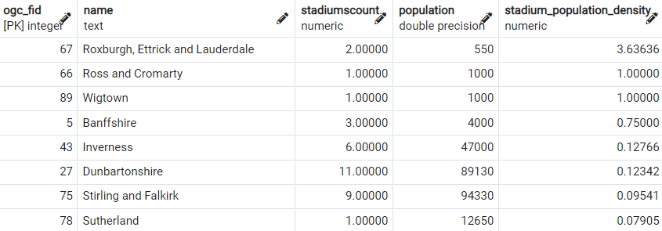
Popularity of Stadiums across UK
Prevalence Equation
No. of Stadiums
Prevalence of a county =
(Population of the city/1000)
Challenge
As highlighted, when the number of stadiums in a county is low and so is the population, then the prevalence equation doesn’t tell the true story.
LOW PREVALENCE
HIGH PREVALENCE

Slide 8
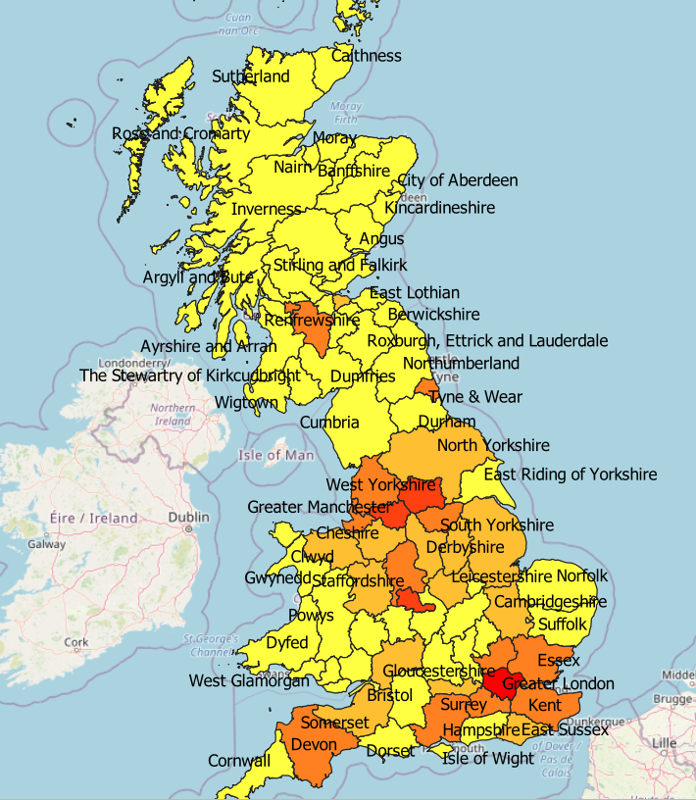
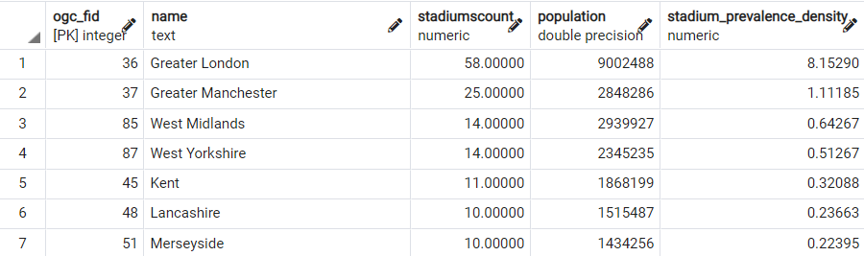
Popularity of Stadiums across UK
Custom Prevalence Equation
No. of Stadiums
Prevalence of a county =
(Total UK population/Population of the city)
Outcome
Greater London has the highest prevalence ratio. Due to its popularity, this city would be the best place to check the rest of the FIFA criteria.
LOW PREVALENCE
HIGH PREVALENCE

Slide 9

Let’s go to Greater London…

Slide 10
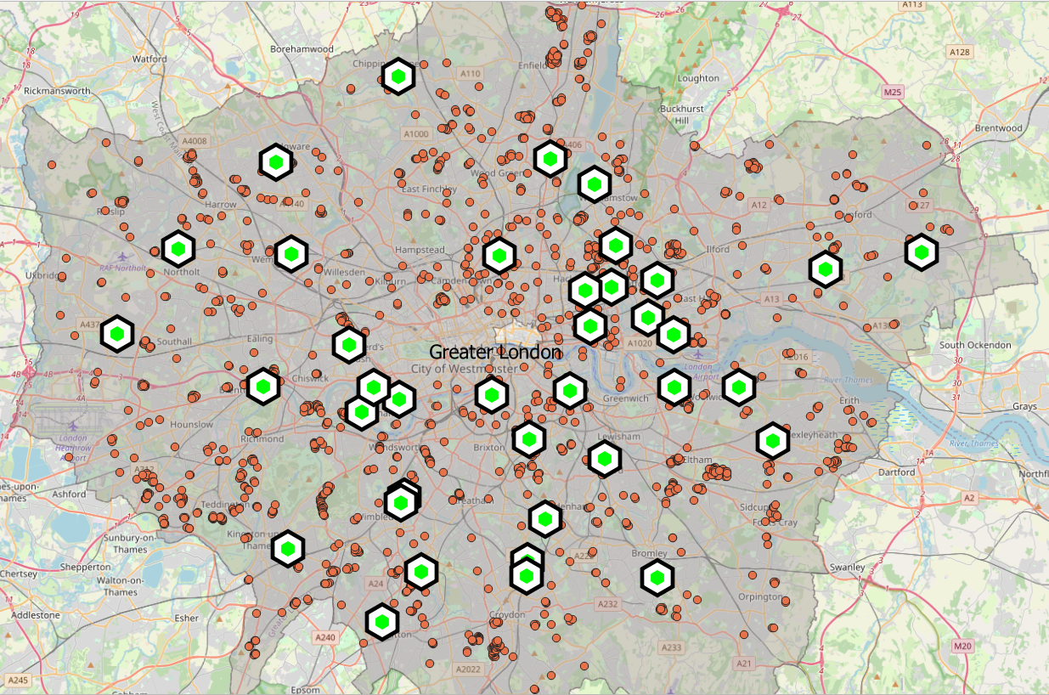
Training Stadiums Criterion
Pro-Soccer Stadiums
Training Stadiums

Slide 11
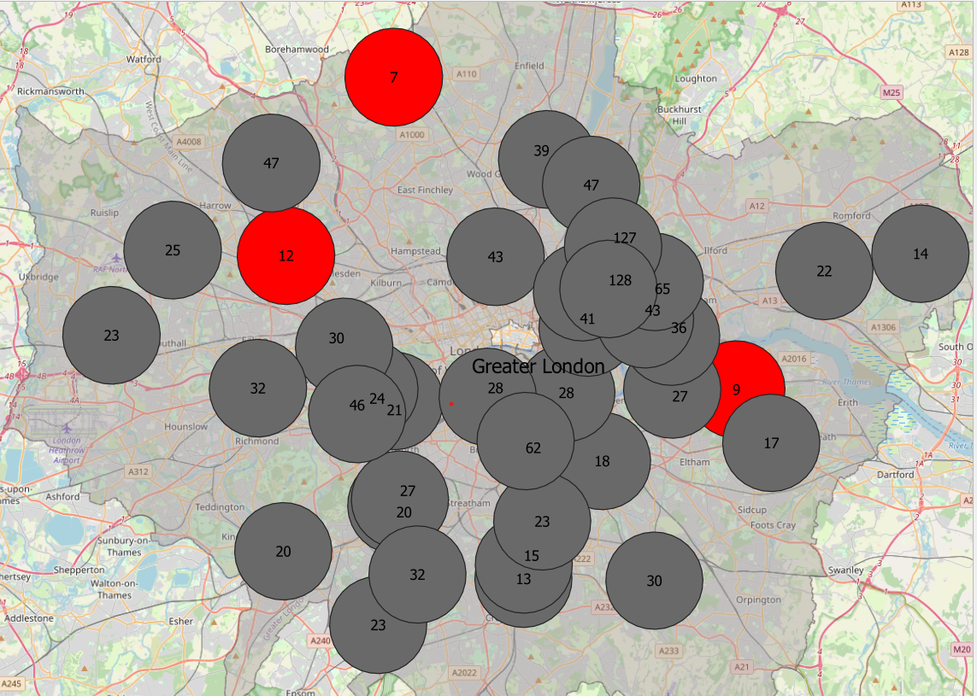
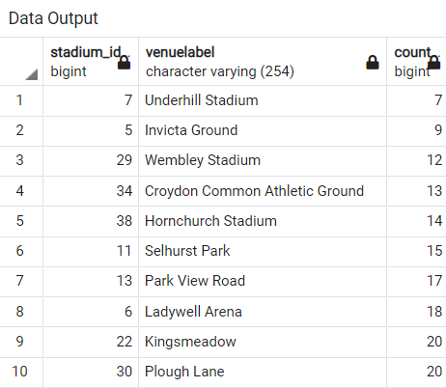
Training Stadium Criteria
CRITERION
At least 12 training stadiums within a 3 Kilometer radius of each main stadium.
Outcome
Underhill Stadium, Invicta Ground and Wembley Stadium do not meet the FIFA standards
Greater than 12
training stadiums
12 or less training
stadiums

Slide 12
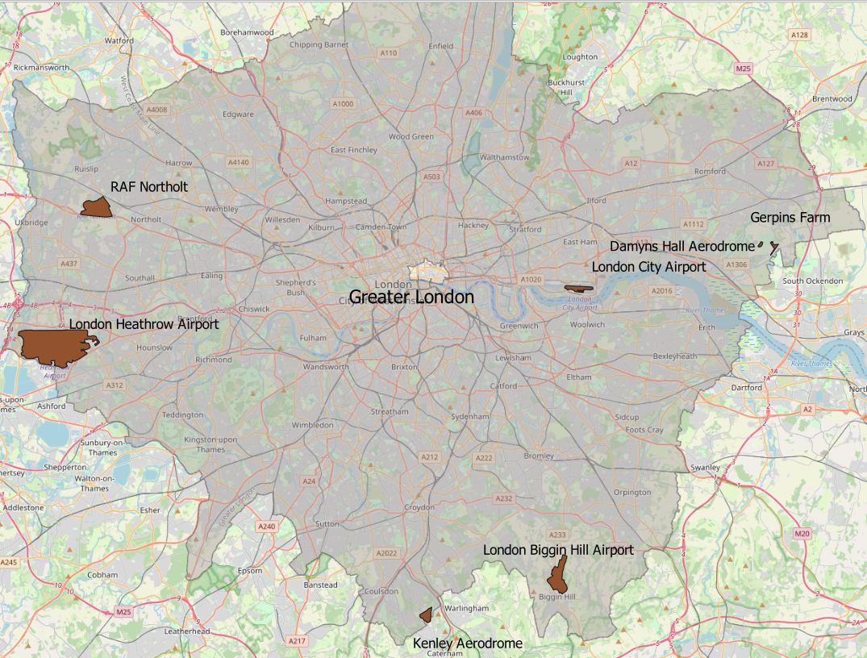
Transportation Criterion
Airports

Slide 13
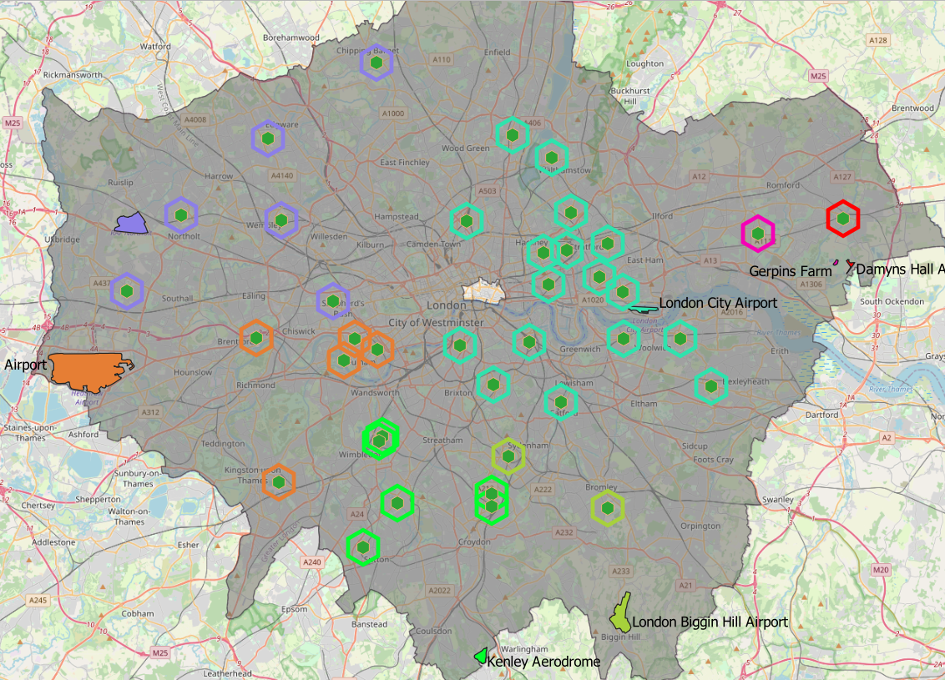
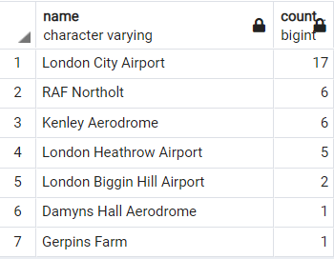
Transportation Criteria - Airports
CRITERION
At least 5 airports in the city and easily accessible to the stadiums
Outcome
Criteria met successfully
Each stadium is tagged to the nearest airport
London City Airport seems to be the most busy airport. It is situated conveniently at the city center making it easier for the fans to travel.
Kenley
London Biggin Hill
Gerpins
Damyns Hall
London City
London Heathrow
RAF Northolt

Slide 14
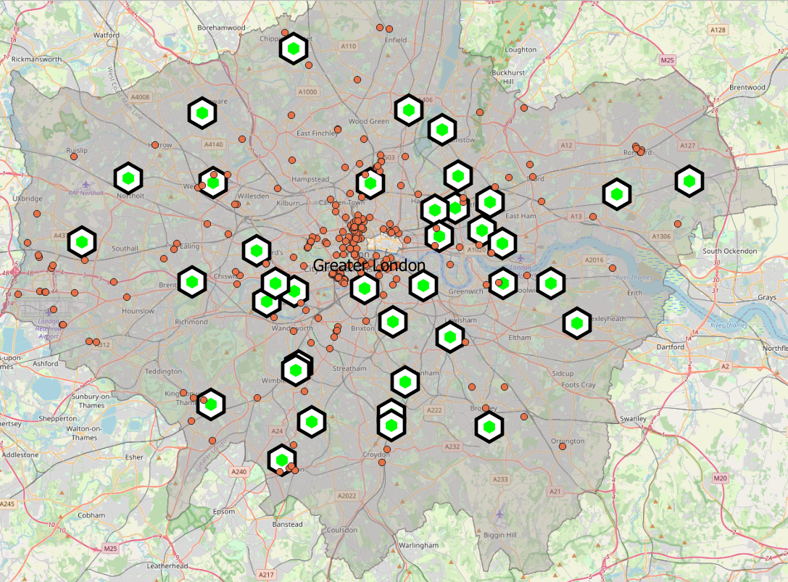
Accommodation Criterion
Pro-Soccer Stadiums
Hotels

Slide 15
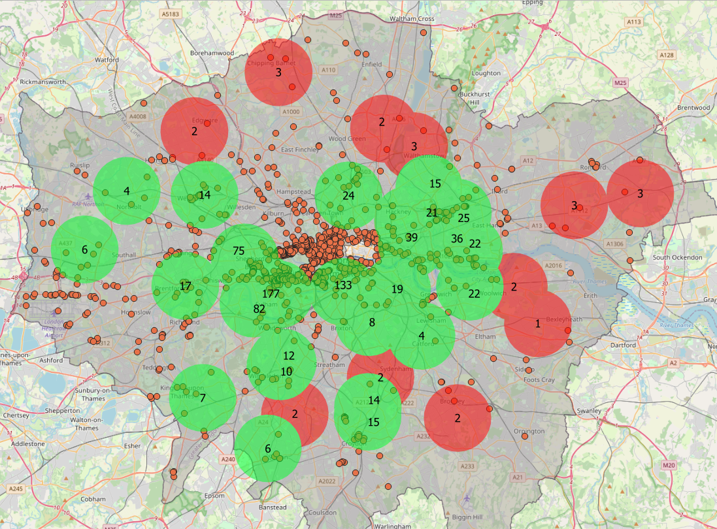
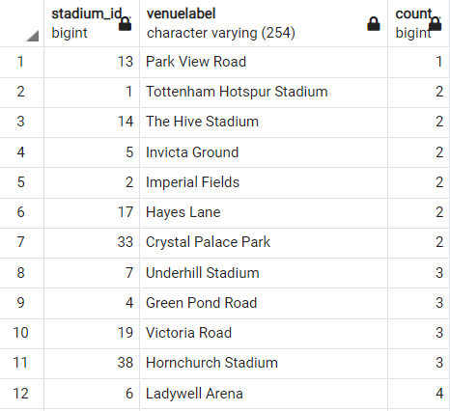
Accommodation Criteria - Hotels
CRITERION
At least 4 hotels within 3KMs radius of each stadium
Outcome
11 stadiums have less than 4hotels in the 3KMs radius from the main stadiums
Hotels
4 or more
hotels
Less than 4 hotels

Slide 16
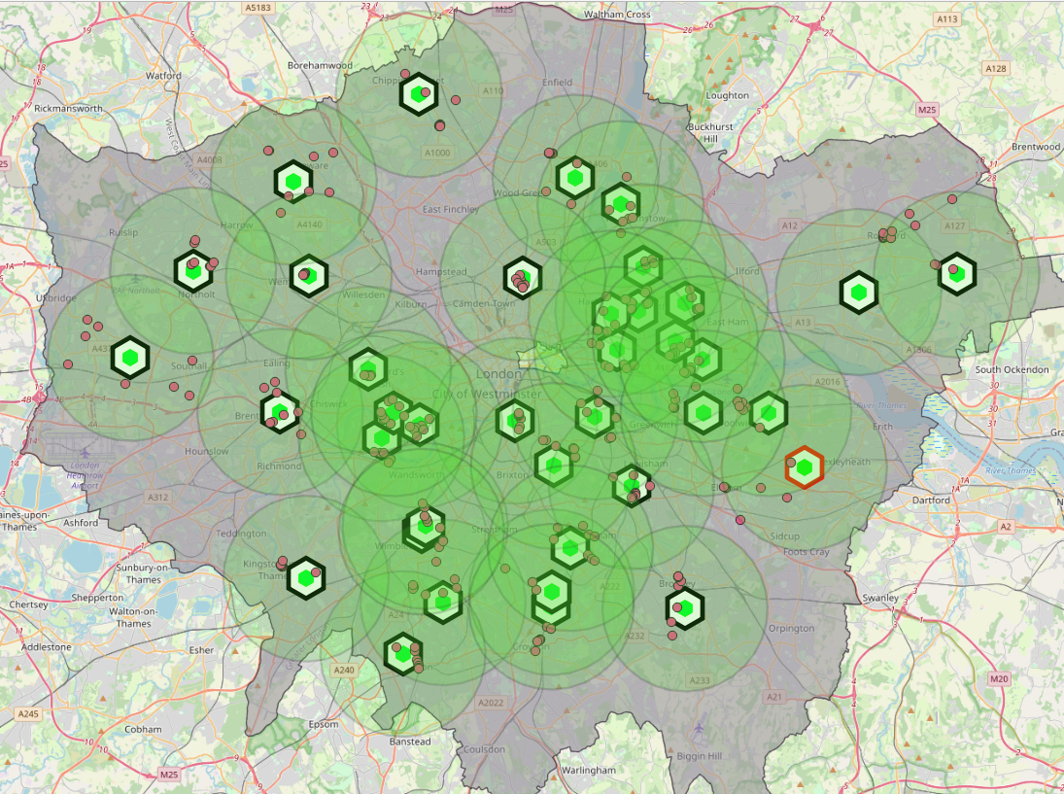
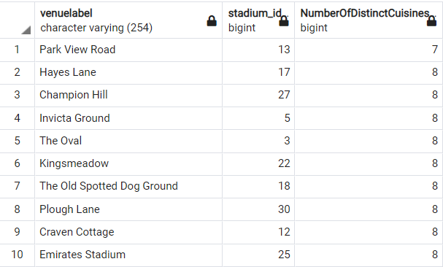
Accommodation Criteria - Restaurants
CRITERION
At least 8 distinct cuisine restaurants within 5KMs from the stadiums for the fans
Outcome
Green circles surrounding the stadiums represent a buffer of 5KM radius.
Park View Road Stadium has 7 choices of cuisines within 5KMs which doesn’t satisfy the FIFA requirements
Nearest restaurant of distinct cuisine
Stadiums with more than 8 cuisines
Stadiums with less than 8 cuisines

Slide 17
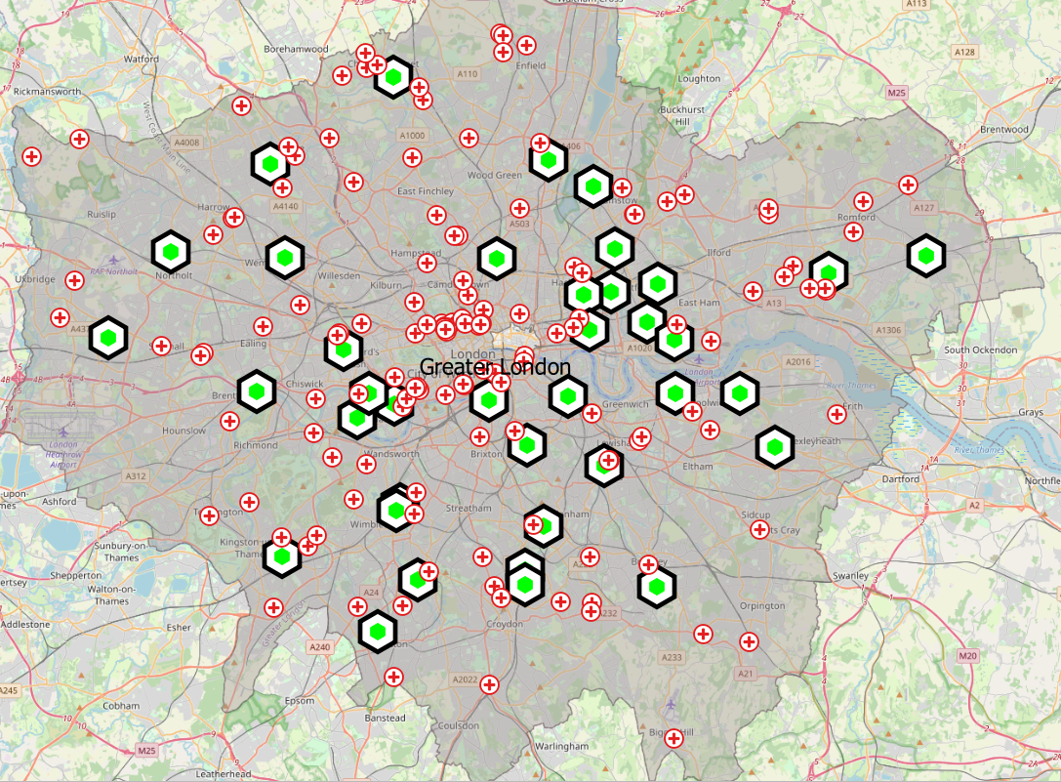

Emergency Criterion
Pro-Soccer Stadiums
Hospitals

Slide 18
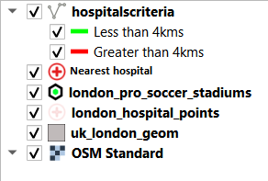
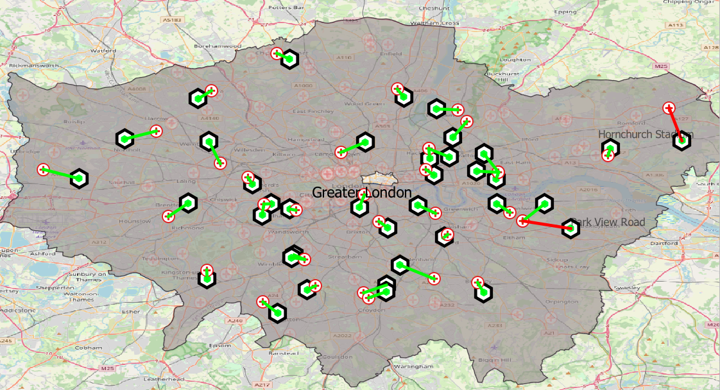
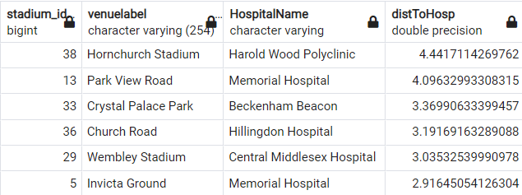
Emergency Criteria - Hospitals
CRITERION
Closest hospital to each stadium should not be more than 3KMs away
Outcome
Hornchurch stadium and Park View stadium do not have access to a hospital in the vicinity. The closest ones are more than 4KMs apart

Slide 19
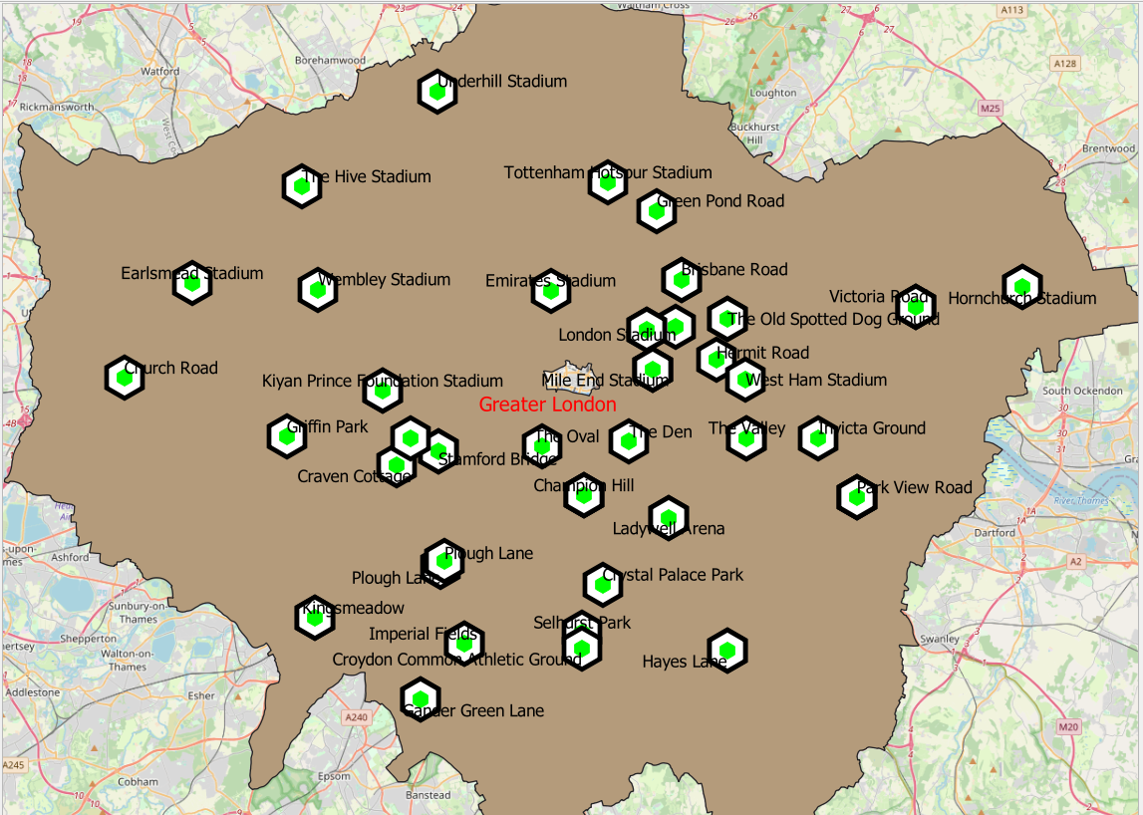
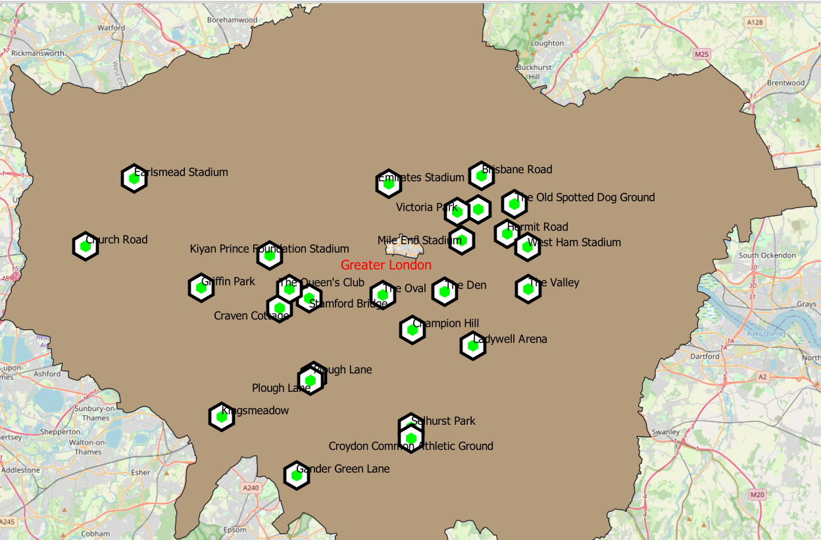
Greater London stadiums meeting the FIFA conditions
There are 26 stadiums that successfully meet all the FIFA requirements to host the World Cup.
Stadiums that meet the criteria are situated mostly around the city center
All of London Stadiums
London Stadiums eligible to host World Cup

Slide 20
SUMMARY
There are 6 cities in the UK that have at least 12 Professional Soccer stadiums
Greater London is the most popular city in the UK for club football
There are 26 stadiums in London that successfully meet all the FIFA requirements.
CONCLUSION
Greater London complies with all the FIFA standards and is the best place to host the FIFA World Cup in the United Kingdom

Slide 21

Thanks for watching!
References
Peter Mooney’s Notes!
https://resources.investormanagementservices.com/the-world-cup-effect/
https://en.wikipedia.org/wiki/FIFA_World_Cup
https://overpass-turbo.eu/
https://wiki.openstreetmap.org/wiki/Main_Page

